Slide 1
DEVELOPER TEST
WEB DEVELOPER #114

Slide 2
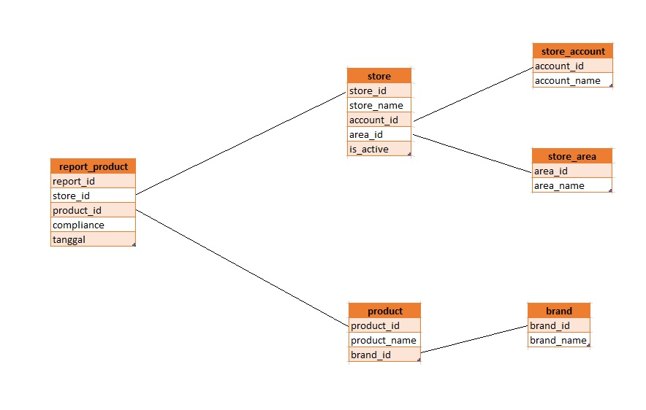
DATABASE

Slide 3
